Slide 1
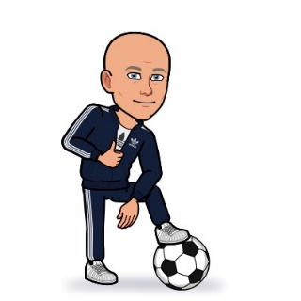
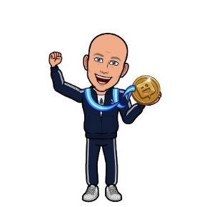
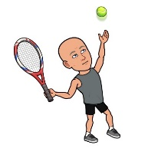
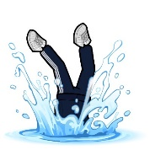
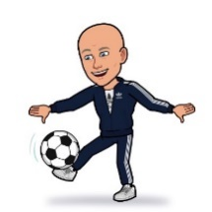
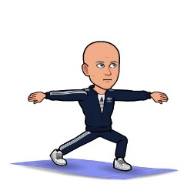
Progression in P.E Curriculum
Competition
The Journey Starts
Interventions to support in KS1
Children will be introduced to competition – Intra / Inter Sportsday / Panathlon / School Games
All children to achieve a GLD by end of Reception
Children identified for additional support with gross & fine motor skills (Enabling / Accessing)
Dance
Year R
Early Years
Key Stage 1
Year 1
Year 2
Children will start to explore different cultures through Dance and take part in Barnet Dance Festival
Fundamental Movement Skills
The Body
Hygiene
Competition Increases
Children will start to learn about their bodies
Children will learn about the importance of Hygiene & Well-being
Key Stage 2
Children will have opportunity for more sports and quality of competition increases to include district and borough compeitions
Year 4
Year 3
Health
Community Clubs
Children will learn about the importance of Healthy Eating, Sleep, Weii-being
Children will be encouraged to join local clubs – Exit Routes / Sign-posting
KS2 Games
Swimming
Will explore transferable skills, knowledge & understanding
Leadership
All pupils will be able to swim 25 m by end of KS2
OAA
Children will have opportunity for Sports Leadership as sports leaders and members of the sports council
Pupils in KS2 will have the opportunity to visit different environments for OAA including residential in Years 5 & 6.
Year 5
Year 6
Sports Specific Skills
Children will learn specific sports skills within lessons applying them in different scenarios and related sports
Strategies, Tactics, Rules, Roles
End of KS2
Children will develop graeter understanding of strategies, tactics and rules for sports. They will take on different roles (e.g. umpire, coach)
Children will leave with a love of PE, physical activity & sport. At High School they will engage in opportunities, clubs, teams. They will choose GCSE PE, Sports Leadership & active, healthy lifestyles

