Slide 1
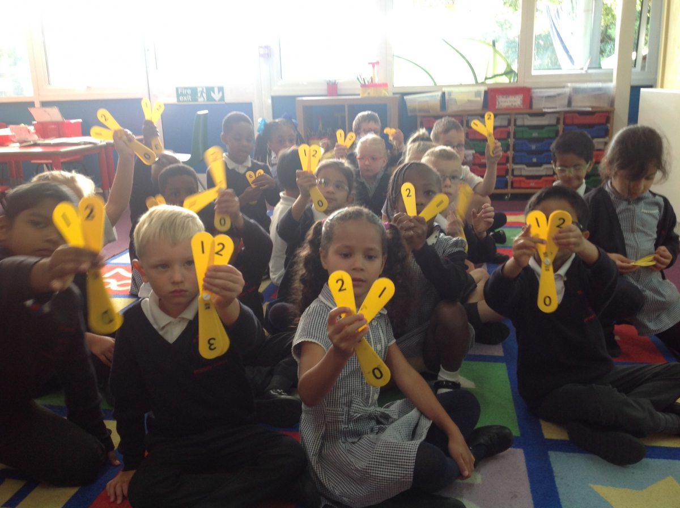
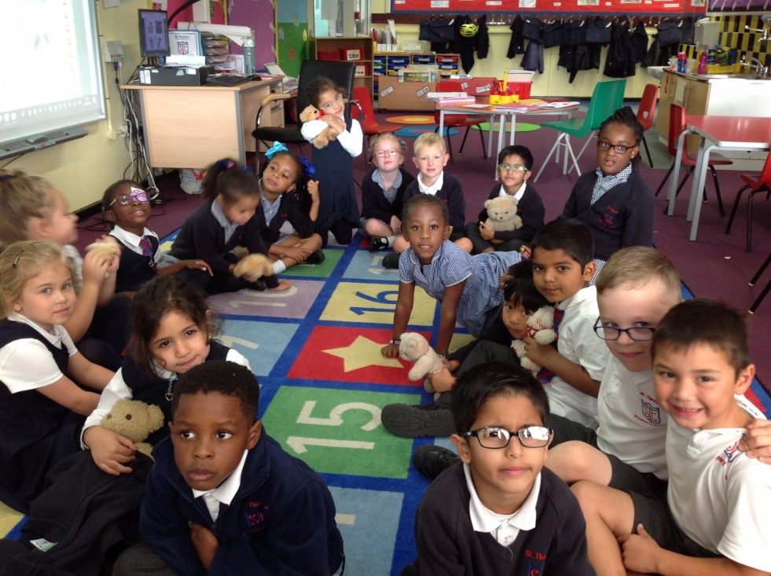
Meeting for Year 2 Parents and Carers

Slide 2
Due to the national lockdown, your child’s June 2020 Y1 Phonic Screening was cancelled.
The DfE has instructed all schools to administer a past version of the phonic screening test to Year 2 pupils in the second half of the 2020 autumn term.

Slide 3
Phases of Phonics
Phase 1
Phase 2
Phase 3
Phase 4 Year 1
Phase 5
Phase 6
Nursery
Reception
Throughout Y1
Throughout Y2

Slide 4
Phonic Terminology

Slide 5
The skill of segmenting
d - u – ck
This is an important skill that aids spelling through phases 2 – 6
Hear and say the individual phonemes (sounds) within words
There are 3 phonemes in the word, ‘duck’
Children who struggle to orally segment often leave phonemes out when spelling longer words e.g. ‘blank’ becomes ‘bank’

Slide 6
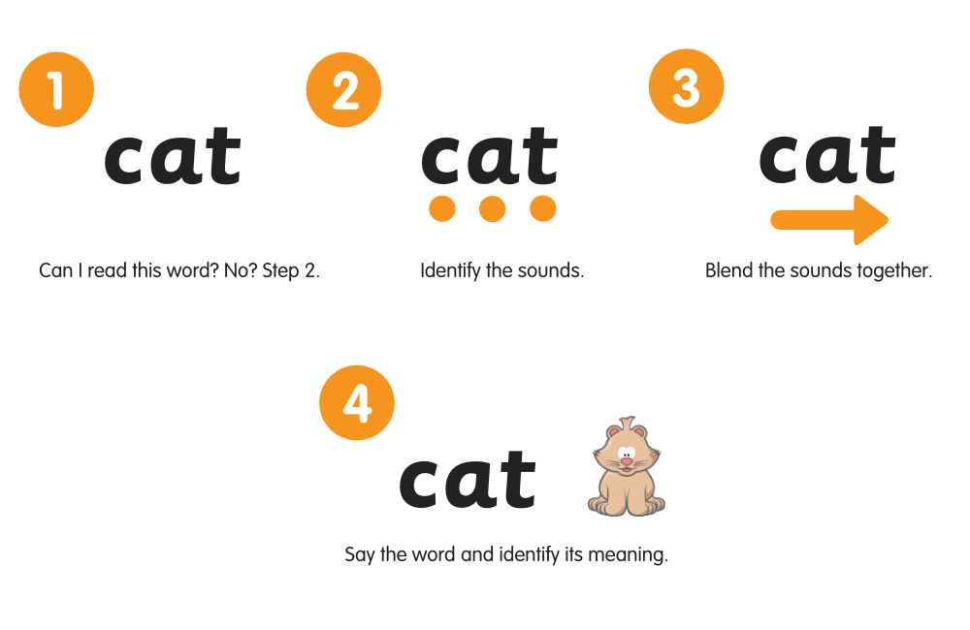
Blending
Merging the individual phonemes (sounds) together to read all through a word.

Slide 7
Segmenting ‘Sounding out words’
We encourage the children to ‘touch and read’ each phoneme with their finger
Draw the phoneme in the air/ floor/ body part

Slide 8
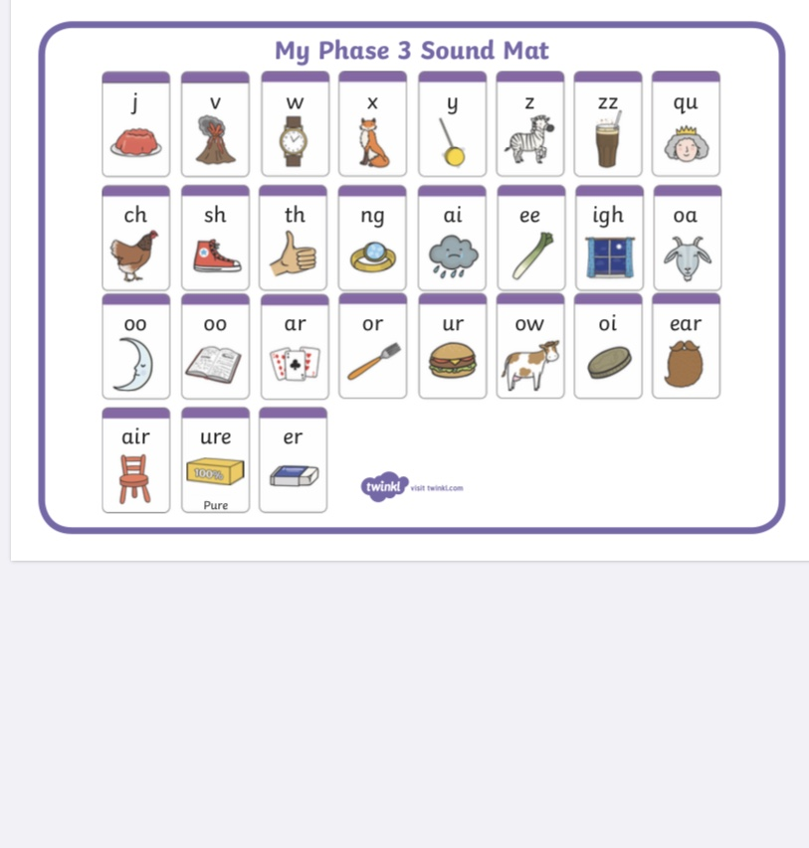
Phase 3: Reception- Recap in Y1

Slide 10
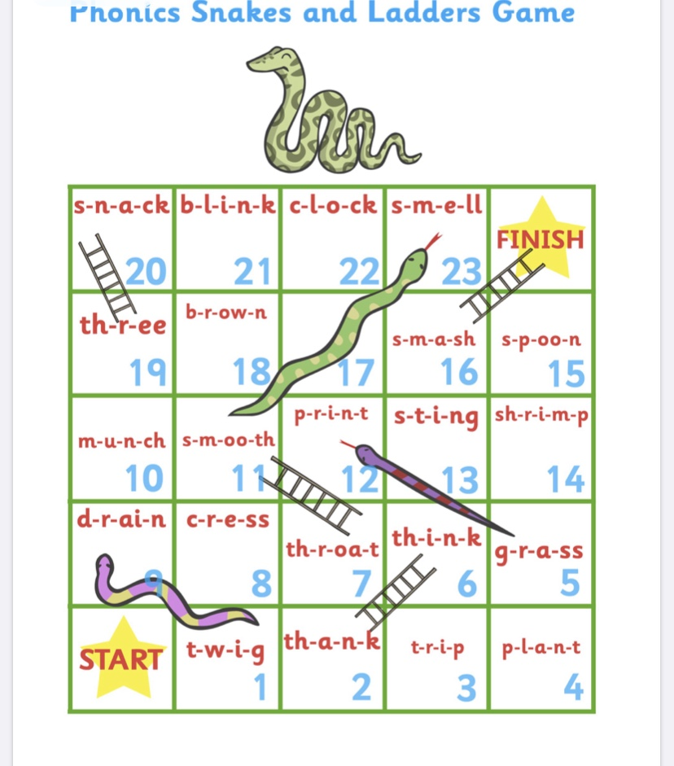
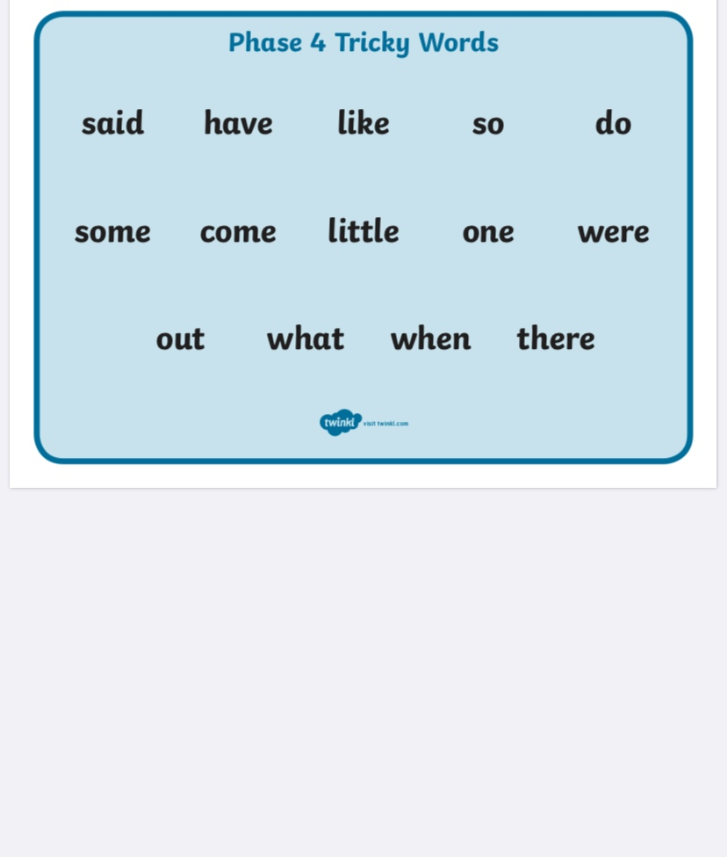
Phase 4 Phonics - no new phonemes to learn!
This phase normally takes 4 weeks to teach and is normally taught in Y1

Slide 11
Phase 4: CVCC words
Children entering Phase Four will be able to represent each of 42 phonemes by a grapheme, and be able to blend phonemes to read CVC words and segment CVC words for spelling.
They will know letter names and be able to read and spell some tricky words.
The purpose of this phase is to consolidate children’s knowledge of graphemes in reading and spelling words containing adjacent consonants and polysyllabic words.
CVC = consonant vowel consonant (D O G)
CVCC = consonant vowel consonant consonant (H E L P)

Slide 12
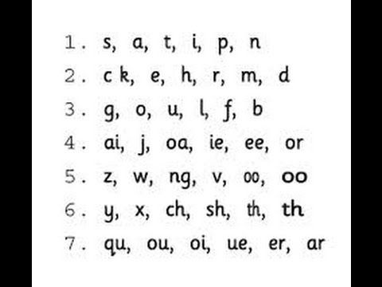
The 42 Phonemes

Slide 13
Phase 5 – taught throughout Year 1

Slide 14
Phonic families in Phase 5
The purpose of this phase is for children to broaden their knowledge of graphemes and phonemes for use in reading and spelling.
They will learn new graphemes and alternative pronunciations for these such as ‘ea’ in ‘bread’ and ‘mean.’
Introduces alternative graphemes for spellings such as ‘ou’ in ‘cloud’ and ‘ow’ in ‘cow.’

Slide 15
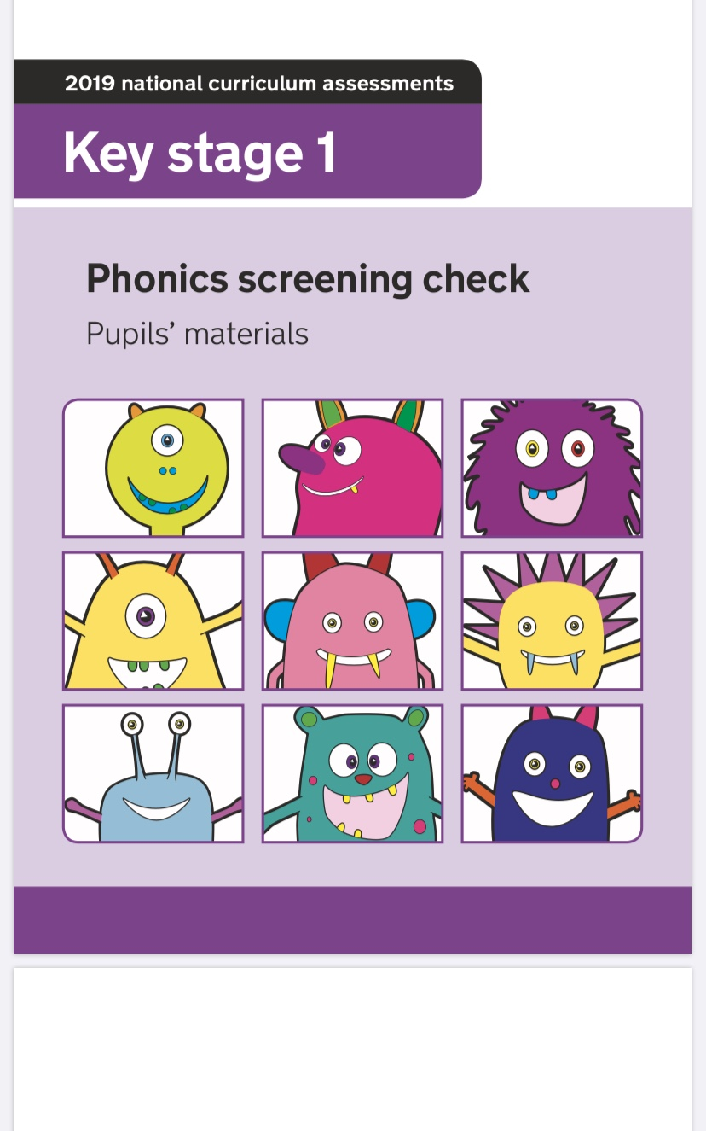

Slide 16
Year 2 Phonic Screening
Schools will administer the Year 2 Phonics Screening Check before the Christmas holidays 2020
Every child in Year 2 must complete the test
Year 2 pupils who meet the expected standard in the autumn term will not be expected to complete any further assessments in phonics
Year 2 pupils who do not meet the expected standard in the autumn term ill be expected to take the statutory check in June 2021 alongside the Y1 pupils

Slide 17
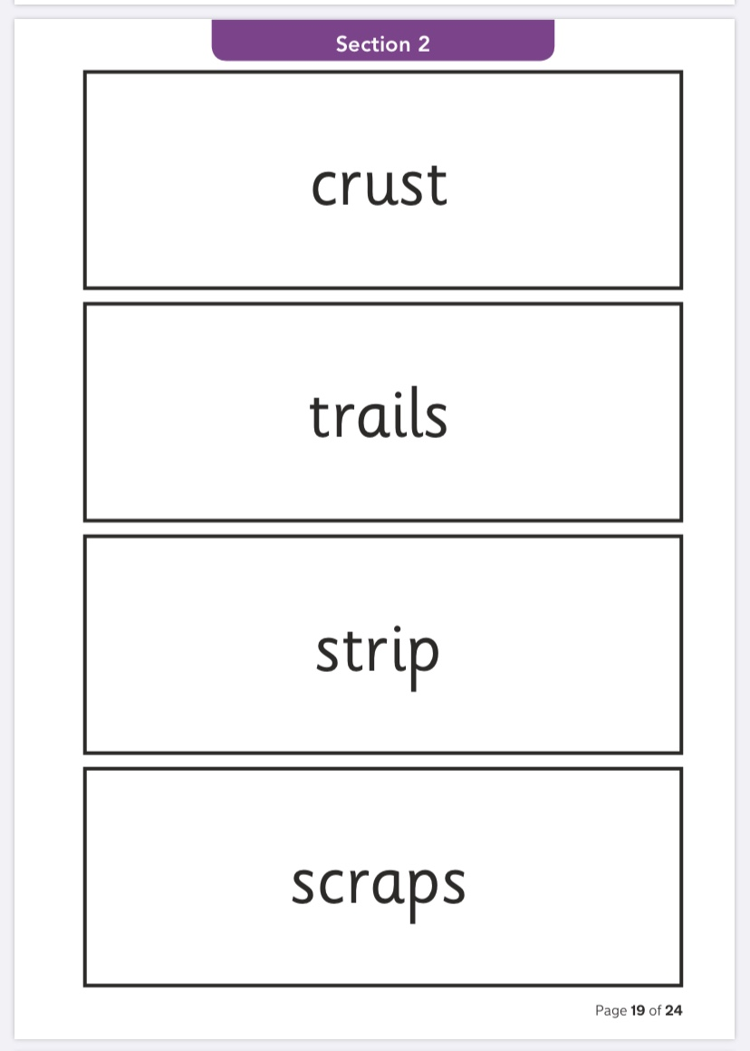
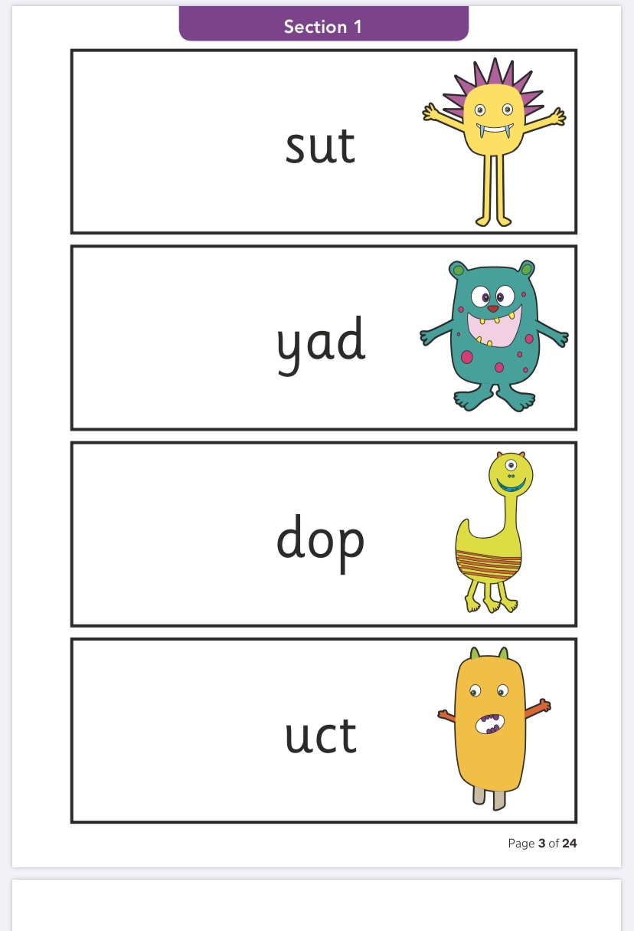
What does the test look like?
The check consists of 40 words which consist of 20 ‘real’ words and 20 ‘nonsense words’

Slide 18
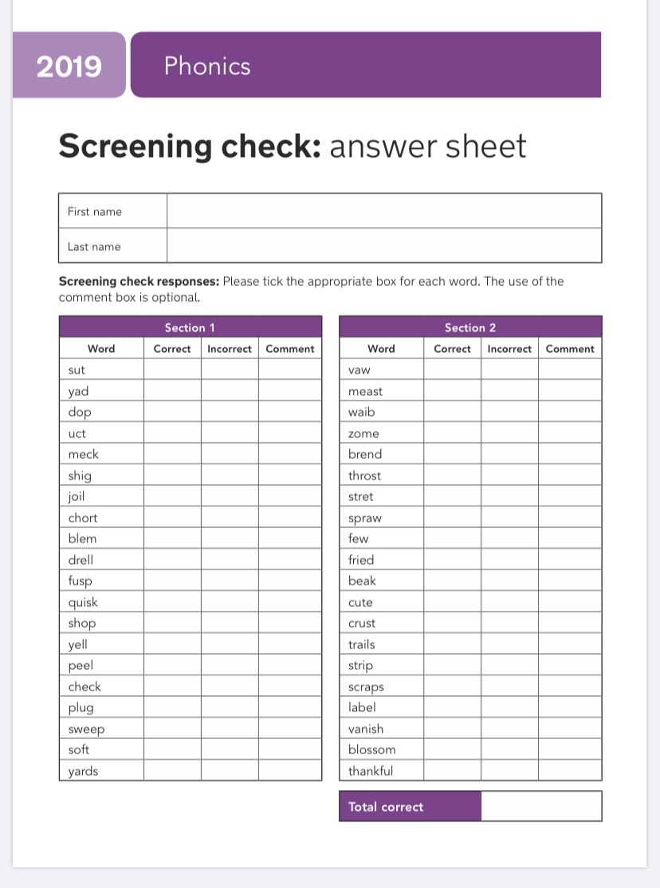
The pass mark is 32 out of 40.

Slide 19
How can I help my child prepare?
You can help your child prepare for their Phonics Screening Check by going over the phonics they have learnt in Reception and Year 1.
Read new books and stories with them where they will be introduced to new words that they will have to sound out.
Provide plenty of opportunities for word reading practice of both Phase 5 real and alien words: children should add their own sound buttons to the word cards and then decide if they are real or alien.

Slide 20
Useful Websites and Apps
Oxford Phonics Generates lists of alien words by Phase.
Mr Thorne- good for enunciation
Phonicsplay- online games we use at school
SpellingShed- your child will be given a login
Teach Your Monster To Read- computer version is free
Alphablocks – short videos practising segmenting and blending skills
Busythings – your child will be given a login

Slide 21
Due to the national lockdown, this year’s May Y2 SATs were cancelled.
All the information in this presentation is based on the DfE confirming that Y2 SATs will go ahead as usual in May 2021. The DfE has given no further details.
Therefore, all other details (i.e. timetabling, format/content of tests etc.) is based on the information issued to Y2 parents this time last year.

Slide 22
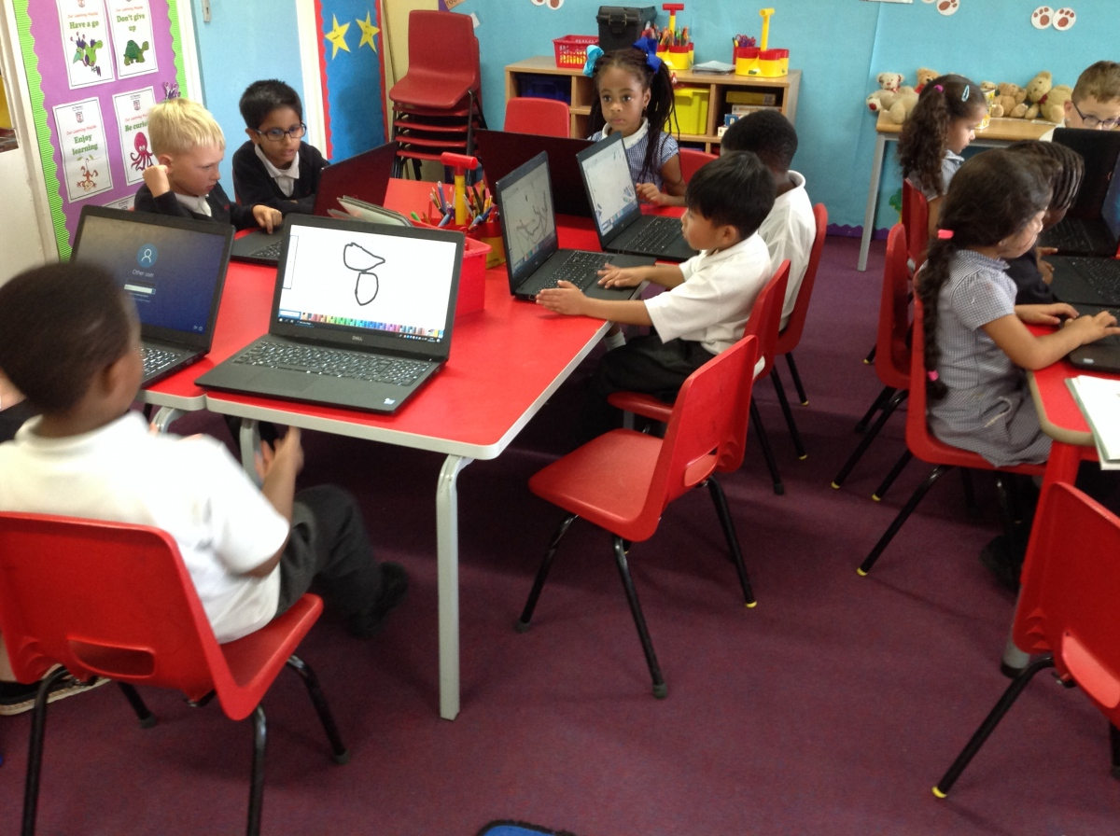
End of Key Stage 1 National Tests
(Key Stage 1 is Y1 and Y2)
The Year 2 pupils will take the tests in May 2021.
The tests assess the pupils against the 2014 National Curriculum.
The tests are marked by the Y2 class teacher.

Slide 23
Reading | English Reading: Paper 1 (20 marks) English Reading: Paper 2 (20 marks)
SPAG (Spelling, grammar and punctuation) | SPAG: Paper 1 (20 marks) SPAG: Paper 2 (20 marks)
Maths | Mathematics Paper 1 Arithmetic (25 marks) Mathematics Paper 2 (35 marks)
NO TEST FOR WRITING
NO TEST FOR SCIENCE

Slide 24
KS1 English Reading Test
Each test includes a selection of unrelated texts of increasing difficulty
A mixture of 2 text types
Paper 2 offered to all pupils (teachers will be able to withdraw pupils at any stage of paper 2 if they feel that children are not able to cope with aspects of paper 2)
For example of Paper 1 (20 marks) click here.
For example of Paper 2 reading booklet click here.
For example of Paper 2 answer booklet (20 marks) click here.
In May 2019 a child needed 25 marks out of 40 to meet the standard.

Slide 25
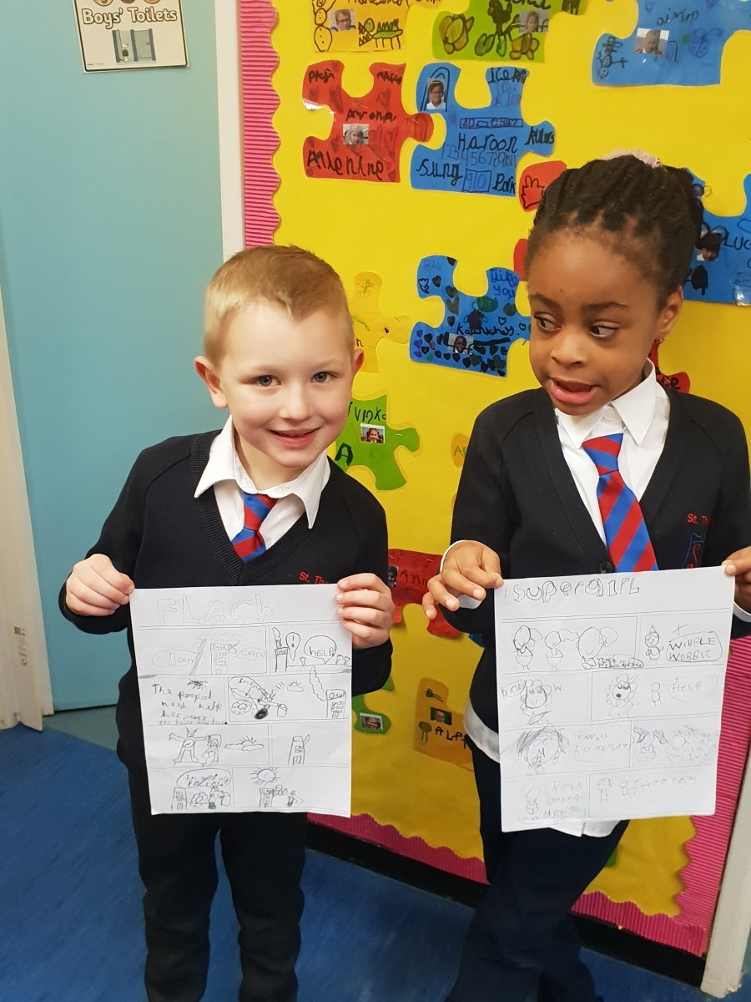
KS1 English Spelling, Grammar and
Punctuation test
Children sit both papers
Paper 1: Spellings
20 spellings (20 marks)
For example click here.
Paper 2: Question paper
20 marks
For example click here.
In May 2019 a child needed 24 marks out of 40 to meet the standard.
In May 2016, following the KS1 SATs spelling paper accidentally being made available on the Department for Education website before the test, Schools Minister Nick Gibb decided the test would be optional in 2016.
This was also the case in 2017, 2018 and 2019.

Slide 26
KS1 Mathematics Test
Children must sit both papers
Paper 1 Arithmetic Paper
25 marks
Not timed
For example of arithmetic paper click here.
Paper 2 Reasoning Paper
35 marks
Not timed
For example of reasoning paper click here.
In May 2019 a child needed 34 marks out of 60 to meet the standard.

Slide 27
How will the tests be marked?
Although the tests are set externally, they are marked by teachers within the school.
Children are given a scaled score. Their raw score – the actual number of marks they get – is translated into a scaled score; a scaled score of 100 means the child is working at the expected standard.
A score below 100 indicates that the child needs more support, whereas a score of above 100 suggests the child is working at a higher level than expected for their age. The maximum scaled score possible is 115, and the minimum is 85.
Click here for an example of the conversion tables.

Slide 28
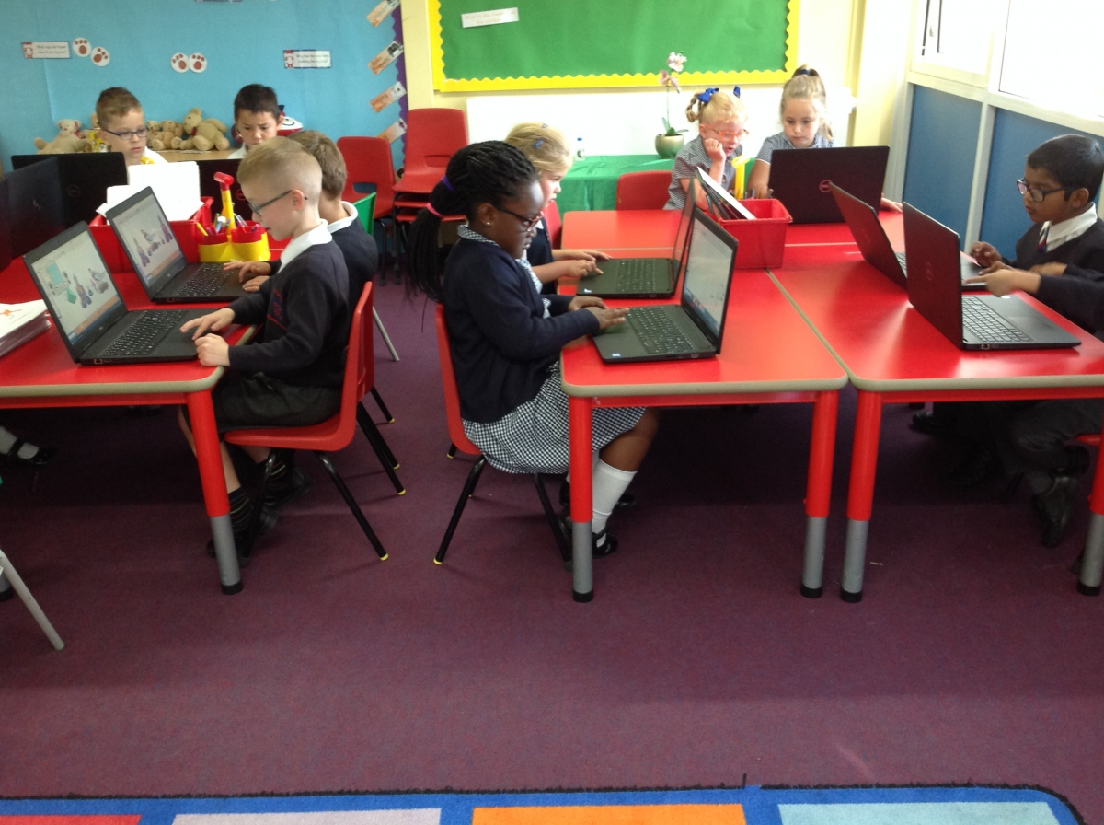
Your child’s TEST results are not sent home.
If you would like to know your child’s test score please ask the class teacher.

Slide 29
2021 KS1 Teacher Assessment
In addition to your child sitting the tests, the teachers will need to determine - at the end of Y2 - whether your child has met the national standard in Reading, Writing, Maths and Science.
This judgement will be based on your child’s learning and progress over the year. This judgement will not be based on the test scores alone.
These judgements will be sent home to parents at the end of June, beginning of July.

Slide 30
Reading | Working towards the expected standard Working at the expected standard Working at greater depth within the expected standard
Writing | Working towards the expected standard Working at the expected standard Working at greater depth within the expected standard
Mathematics | Working towards the expected standard Working at the expected standard Working at greater depth within the expected standard
Science | Working at the expected standard Has not met the expected standard

Slide 31
Parents will be regularly updated with their child’s assessment levels in reading, writing and maths.
Parent consultations will be in November and February.
Parents will receive the annual written report at the end of the Summer term.

Slide 32
Expectations of Y2 pupils
Highest standards of behaviour
Being ready to learn
Commitment to their learning (presentation, concentration, effort, resilience)
Commitment to their homework – completing and handing in on time

Slide 33
How can parents help?
Encourage their child’s independence
Let them take responsibility for their work and actions
Ensure there is a calm, quiet environment for homework
Ensure that time is organised within the family ‘routine’ for school work
Bedtime routine
Healthy lifestyles
Read every day

