Slide 1
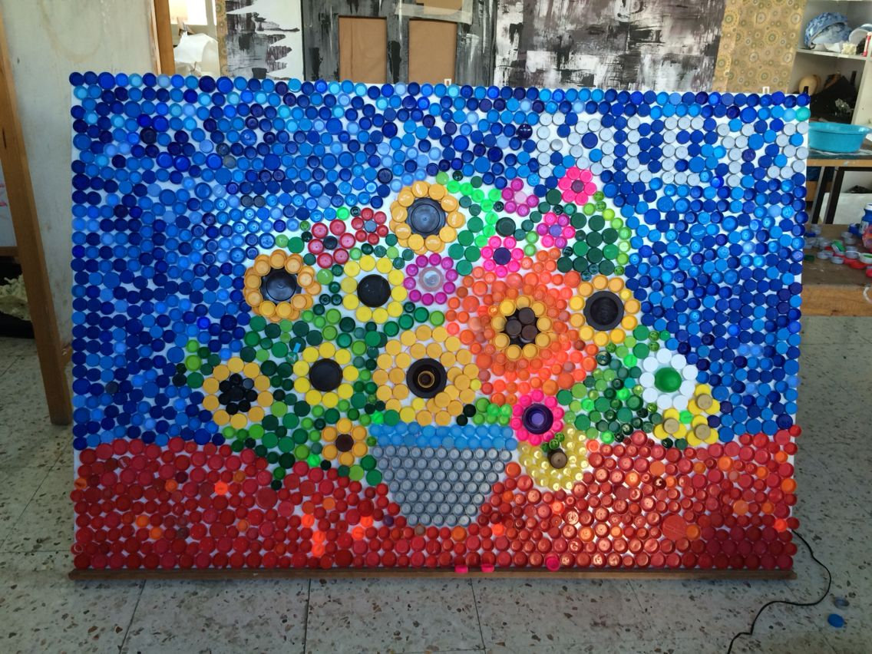
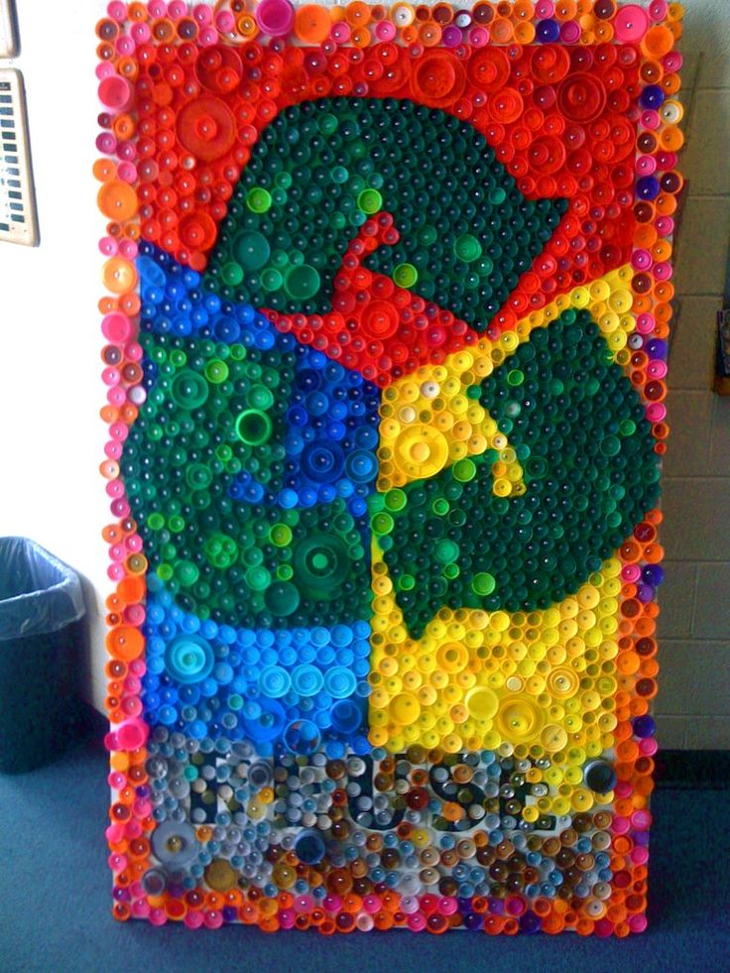
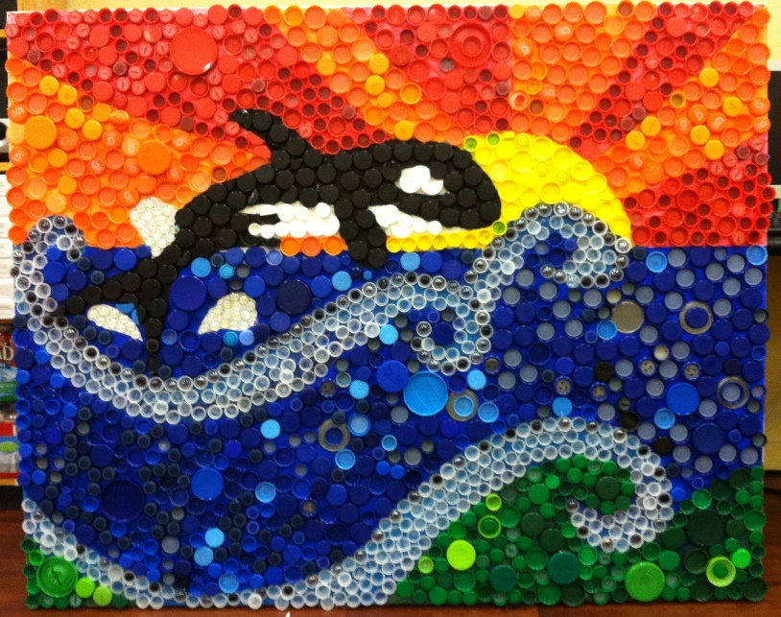
St Theresa’s Bottle Cap Mosaic Design Competition!

Slide 2
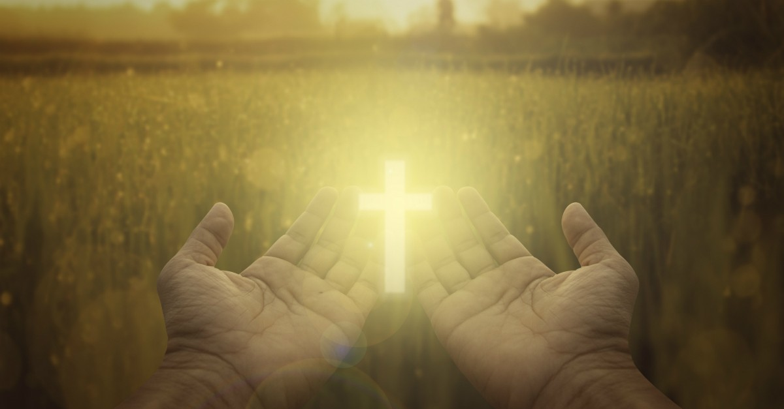
The Theme is ‘Stewards of God’s Creation’.

Slide 3
What does the Bible say about Stewardship? According to scripture, God created Earth for mankind and we are now stewards of His creation. This means it is our responsibility to look after and take care of this world. We should accept this responsibility and appreciate God's gift of creation for being our home. Our stewardship of creation involves the caretaking of the environment and animals as well as our families and communities. Charles Bugg defines stewardship in the Holman Bible Dictionary as "Utilizing and managing all resources God provides for the glory of God and the betterment of His creation."

Slide 4
The competition
Each child will get the opportunity to create a design for our school mosaic.
The winner will be picked by the school and the winning design will have their creation made for the whole school to see!
Please use the template given and remember to put your name on your design!

Slide 5
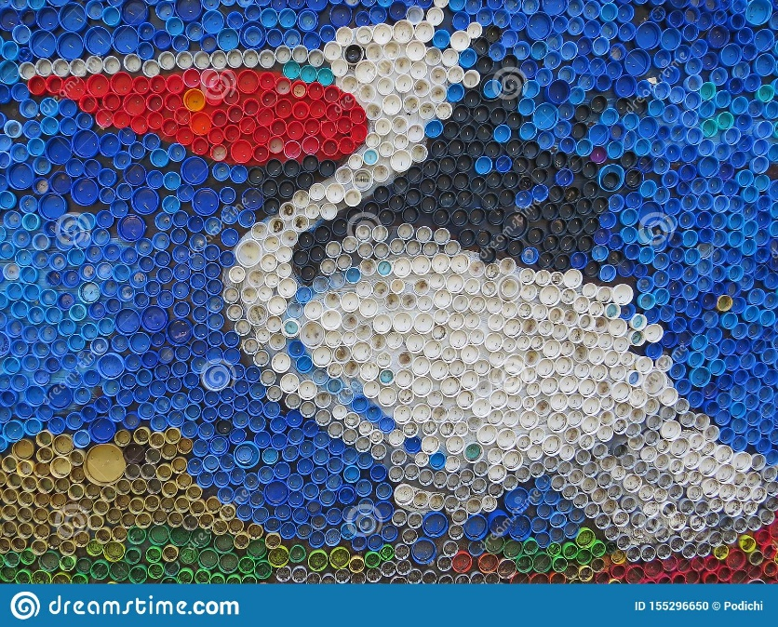
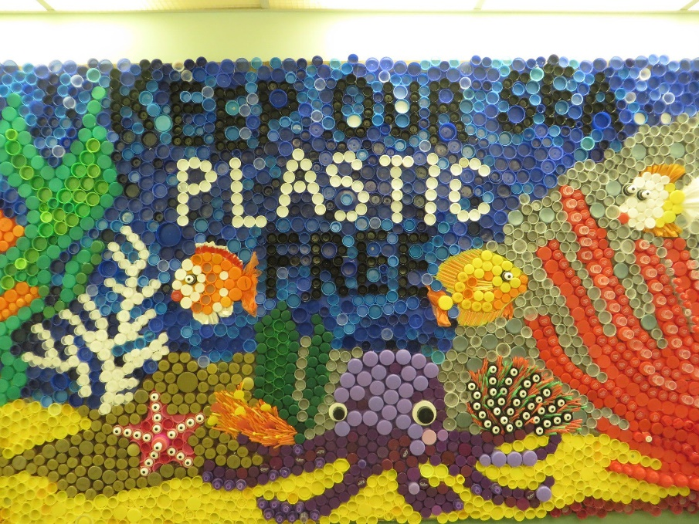
What could your design look like?
Save our seas
Recycling
Helping wildlife
Stop Polluting

Slide 6
How can you help?
Bring in your bottle caps!
We will be collecting as many bottle caps as possible to help with recycling and also to make our great creation!
Make sure to put your name on your entry!

