Slide 1
What the writing process looks like at St Theresa’s

Slide 2
Aims of session: By the end of the session we will have…
A consistent approach to the writing process within the school.
Planning that allows for progression of skills within the writing of our children.
A broad writing curriculum that allows children to show their learning from other aspects of the curriculum and their own interest and experiences.
A variety of effective A4L strategies that move writing forward.

Slide 3
What works really well in our classroom?

Slide 4
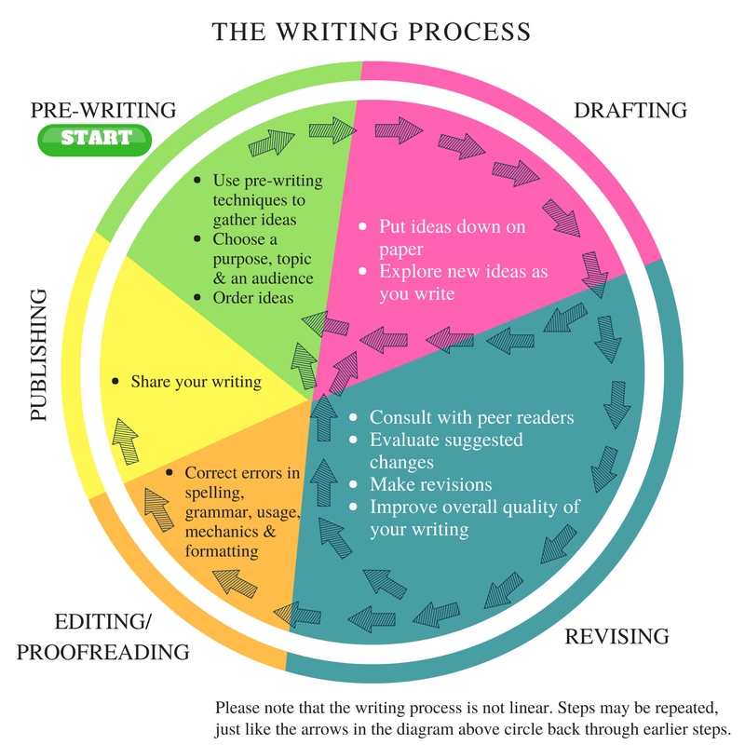
The Writing Process.
Which of these do we do a lot in class? Which do we maybe sometimes forget or not spend as much time on?

Slide 5
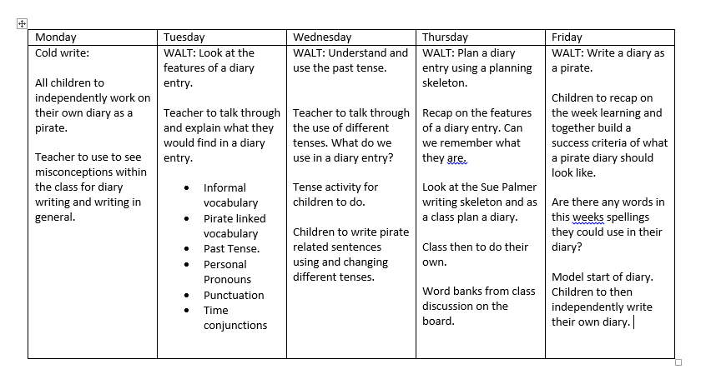
What this might look like in practice

Slide 7
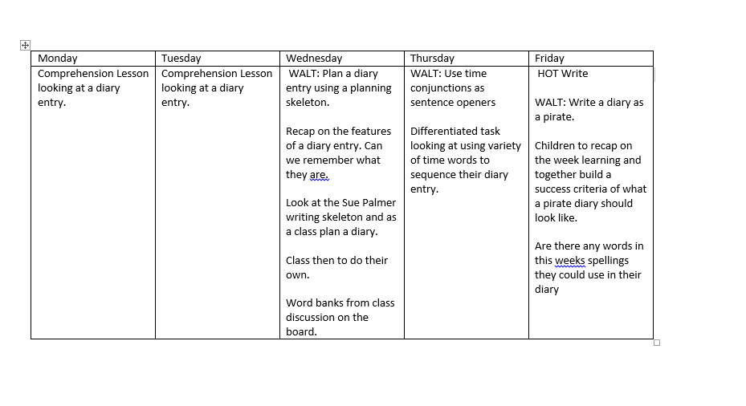
Please note some of the writing will be done in other areas of the curriculum e.g Topic, Science, R.E

Slide 8
Cold and Hot Task at the end of each writing unit.
A Cold Task is an exercise at the beginning of every unit, or genre in literacy. The children have a go at doing the task – for example, if they’re doing poems they have a go at writing a poem.
They then do all the unit of work and the teacher teaches them how to improve their work. At the end of the unit they do a Hot Task, which is a second go at doing the same piece of work.
What it does is it allows the teacher to be able to build on what the child already knows. Instead of just teaching them all the same thing, the teacher can see if a child can already do some of the task, and can focus their teaching accordingly.
There are great benefits for the child, because they’re really able to see the difference between what they could do before and afterwards.
It’s a great celebration for them, as well as for parents and for us, and it’s also a clear indication of progress for Ofsted.
NOTE: Writing on cold tasks should also show progression of skills from previous writing genres!!

Slide 9
Genres covered in each year group
Each year group should be looking at covering 2/3 writing genres per half term to ensure they are covered in depth.
Topic based planning using a text as a stimulus (Take One Book): Allows teachers a wider creative freedom and an enhanced opportunity to focus on the ‘reading for pleasure’ element of the curriculum. One book is chosen, and from this, a variety of outcomes could be produced, and links made across the curriculum where appropriate.
Fiction Modules: As children progress through Key Stage 2, narrative units vary their focus e.g from plots in year 1 and 2 to other aspects of narrative writing such as characterisation and creating atmosphere. In every year group there are opportunities for children to plan and write whole narratives.
Non Fiction Modules: Long term plans are designs to ensure whole school coverage of 5-6 non- fiction genres. There is alignment with other aspects of the curriculum e.g where children need to explain in science.
Poetry: Three aspects of poetry addressed in each year group: Vocabulary building; structure e.g Haiku and poetry appreciation (Take one poet per year group can become familiar with their work – poetry week Autumn 1).

Slide 10
Writing across the year: an example.

Slide 11
Importance of Planning: Sue Palmer Planning Skeletons

Slide 12
Culture Capital: Vocabulary opportunities

Slide 13
Marking and A4L opportunities
Box marking
Pupil and Peer assessment (Independent writing in books)
Whole Class Feedback
Hot and Cold writing referring to feedback and progression of text type.

Slide 14
What the writing process should look like at St Theresa’s
Multiple opportunities for children to write the same text type to show progression of skills included those related to their topic and interests.
Identifying features of genres and comparison of examples
Planning skeletons used and visible in books for children to refer to when writing.
Opportunities for children to perform talk4writing,
Vocabulary being built by other aspects of the curriculum, guided reading and reading for pleasure.
A4L techniques used.
Children and teachers referring to last piece of work and marking.

