Slide 1
Miss Mangan
Miss Barber & Mrs Katin

Slide 2
School Contact Details
School contact details
Telephone: 020 8346 8826 Fax: 020 8346 0215 Email: office@sttheresas.barnetmail.net
School Website
https://www.st-theresas.barnet.sch.uk/
School Twitter page
@StTheresasCath1
https://twitter.com/StTheresasCath1?ref_src=twsrc%5Etfw%7Ctwcamp%5Eembeddedtimeline%7Ctwterm%5Eprofile%3AStTheresasCath1&ref_url=https%3A%2F%2Fwww.st-theresas.barnet.sch.uk%2F

Slide 3
Mission Statement
At St. Theresa’s
We learn together,
We play together,
We pray together and
We grow together in the love of God.

Slide 4
Growth Mindset

Slide 5
Curriculum Map:

Slide 6
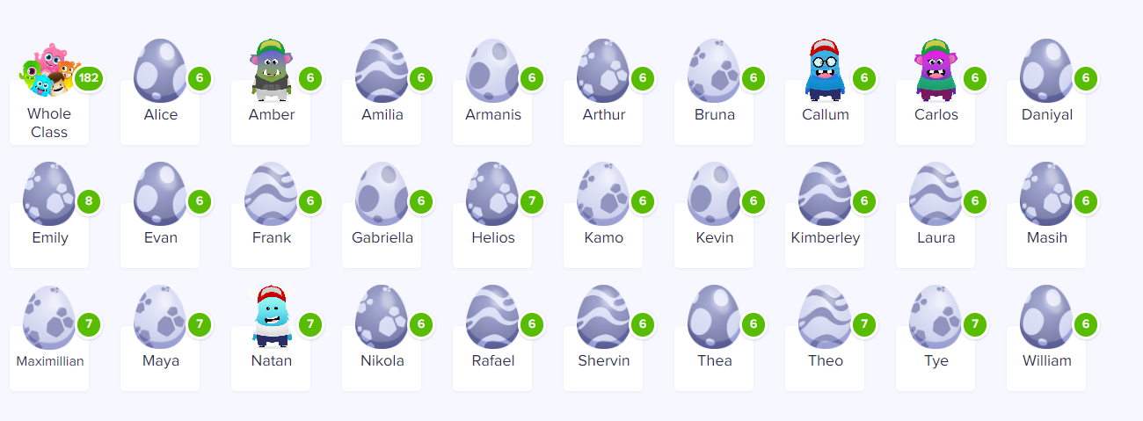
Behaviour
The children took ownership of their class rules and agreed on them together. In class the children receive dojos for good effort and attitude which parents can view from the app.
Alongside this, for exceptional good behaviour the children get to put their name in our lucky box and at the end of the week we will pick out two student names to receive a prize.

Slide 7
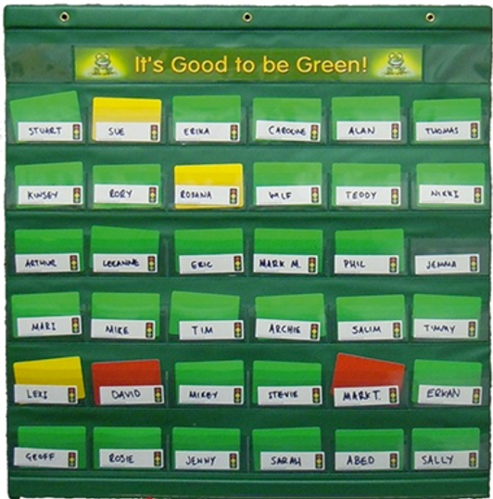
Behaviour Plan
Consequences of negative behaviour.
We use a warning system in class. (Good to BE Green)
1) Verbal reminder.
2) First warning.
3) Second warning- 5-10 minutes time out either during class time or break time.
4) Letter sent home and speak to parents. Sent to Miss Costa or Mr Troy.
If a serious incident occurs child is sent straight to Miss Costa or Mr Troy and parents will be informed.

Slide 8
Times Tables
Times Tables Tests
The Times Tables test will be every Friday after half-term. This is a chance for the children to practise their mental maths strategies. There will be a big focus on Mental Maths this year in preparation for next years multiplication assessment.
During Autumn 1 we will recap 2s, 5s, 10s before moving on to 3s, 4s and 8s throughout the rest of the academic year.
Times Tables Rockstars (log ins will be sent home with students)
At home the children can use the Times Tables Rock star's website. The children can access their account at home to play a range of games and activities.

Slide 9
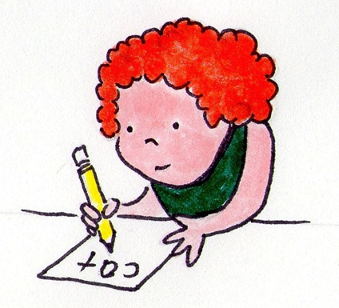
Home Learning
Take Away Homework
This will be posted on Seesaw at the start of each half term. There will be a total of 12 homework activities for the children to try.
Each Tuesday they must return one of the activities for the class teacher to acknowledge and mark. This must be posted on Seesaw for the class teachers to see.
Maths
Maths homework will be set on Mathletics every Tuesday. This doesn't need to be returned via Seesaw to the class teachers as the teacher can view completed work on the website.
Spellings
Spellings will be posted on Seesaw every Tuesday and will be tested the following Tuesday.

Slide 10
PE Days
Year 3 have NSA every Tuesday morning. They must come to school in their full PE kit for their lesson.
Year 3 also have class PE with NSA on Friday mornings. They must also come to school in their full PE kit for their lesson.
Please remember to dress accordingly for the season. Many of the sessions will be outside so they may need extra layers.

Slide 11
Resources
Pencil Cases
Children are required to bring a pencil case that will remain in school. Please ensure all equipment is labelled. Children are not allowed to share equipment with others.
This must include:
Writing pencils, rubber, ruler, sharpener, purple pen, a white board pen, glue stick, coloured pencils, highlighter, red pen.
Water Bottles
Please ensure children bring a water bottle to school.
Fruit/Snack
Children are allowed to bring a fruit to have during their morning break and it would be encouraged that they do as it is a long time from breakfast to Lunch.

Slide 12
Labels
Please ensure that you have everything belonging to your child labelled. It is very difficult to return lost belongings when they aren’t labelled.

Slide 13
Communication
For your information:.
You can contact Miss Mangan via Seesaw for any brief questions and support you may need.
If you would like a meeting, please email/call the office and arrange a suitable time after school for the teacher to meet with you.

Slide 14
Ways to support your child at home
Reading
Please ensure children are reading for AT LEAST 20 minutes each night.
https://readtheory.org/auth/login
Times Tables
https://ttrockstars.com/
Spellings
https://www.spellingshed.com/en-gb/
Maths
https://www.prodigygame.com/main-en/

Slide 15
End of Year 3 Maths Objectives
Number and Place Value
Counting in steps of 4, 8, 50 and 100
Recognising place value of each digit in a three-digit number
Comparing and ordering numbers to 1000 and writing these numbers in numerals and words
Calculating
Adding and subtracting with numbers up to three digits using column addition and subtraction
Knowing multiplication facts for the 3, 4 and 8 times table
Multiplying two-digit numbers by one-digit numbers
Fractions
Finding fractions of quantities
Understanding equivalent fractions
Adding and subtracting fractions with the same denominator
Measuring
Adding and subtracting measurements of length, weight and capacity
Working out the perimeter of simple 2D shapes
Adding and subtracting amounts of money
Telling and writing the time using the 12-hour and 24-hour clock
Geometry
Drawing 2D shapes and making 3D shapes
Recognising right angles and identifying whether angles are greater or smaller than a right angle
Identifying horizontal and vertical lines and pairs of parallel and perpendicular lines
Statistics
Interpreting and presenting data using bar charts, pictograms and tables
Answering one-step and two-step questions about the data presented

Slide 16
End of Year 3 English Objectives
Writing
understand how to spell words with a variety of prefixes and suffixes
become more confident in joining their handwriting, increasing its legibility and quality
use a wider range of connectives (when, before, after, while, so, because)
start using inverted commas to punctuate speech
create settings, characters and plot in narratives using a range of descriptive language
use organisational devices such as bullet points and sub-headings
assess and improve their writing
Reading
apply their growing knowledge of root words, prefixes and suffixes to read aloud and understand the meaning of new words they meet
read a range of fiction, poetry, plays and non-fiction texts
re-tell stories orally
perform poems and play scripts, showing understanding through intonation and action
infer characters' feelings though their actions, justifying their inference with evidence
identify main ideas drawn and summarise these
Children should be allowed to choose a book at school to take home with them to read. You may be given an exercise book to write your comments in when you read with them. Children will also read with their teacher in groups once a week (this is called guided reading).

Slide 17
We would like to add that we wish your child a very happy time in Year 3. Should you have any questions, however big or small, then we would be more than happy for you to contact us.
Miss Mangan.

