Slide 1
Year 4 Multiplication Tables Check
“Pupils should be taught to recall multiplication and division facts for multiplication tables up to 12 x 12”
Gov.uk

Slide 2
What is the Year 4 times tables Test?
First announced by the Department for Education (DfE) in September 2017.
The three Rs still reign supreme in the National Curriculum – Reading, wRiting and aRithmetic.
Times tables fall under arithmetic. All primary school-aged children are expected to know their times tables up to 12 x 12 by heart. Children are expected to master their times tables by the end of Year 4.

Slide 3
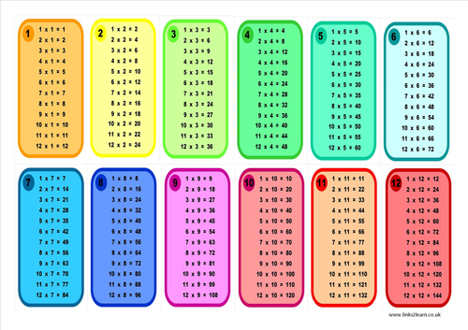
The idea is for the Multiplication Tables Check to be taken towards the end of Year 4 to make sure children are meeting the benchmark of memorising their times tables up to 12 x 12 before moving up to Upper Key Stage 2 (Year 5 and Year 6) and then secondary school.
The DfE says that the check is part of a new focus on mastering numeracy.

Slide 4
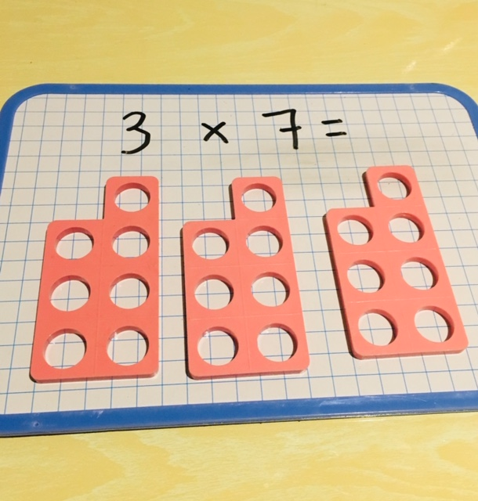
Who will take the test?
Schools should administer the check to all pupils in Year 4 unless the Headteacher decides it would not be appropriate for a pupil to take the check.
The Headteacher’s decision
regarding participation is final.

Slide 5
Pupils should not take the check if any of the following apply:
they are absent during the entire 3-week check period
they are unable to access the check, even when using access arrangements
they are working below expectation for year 2 in multiplication tables and are considered unable to answer the easiest questions
they have just arrived in school during the check window, with EAL, and there is not enough time to establish the standard at which they are working
they have been incorrectly registered for the check
they have left the school before the check period

Slide 6
When will my child take the test?
Schools have a three-week window in the month of June to have their Year 4 children sit the test, but will be free to choose which day within that three-week period they choose to sit it.
Monday 5th June to Friday 23rd June
We will be able to try it out from Monday 17th April.

Slide 7
How will the children be tested?
The Multiplication Tables Check has been described as “an online, on-screen digital assessment” – meaning the children can take the test on a desktop computer, laptop or tablet (such as an iPad) at school.
At St. Theresa’s we will be using iPads.

Slide 8
The times tables test will be timed, with the entire assessment lasting approximately 5 minutes in total.
The children will be set three practice questions to begin with – mostly from the one times table.

Slide 9
Following the practice questions, the test itself will comprise of 25 questions, all formatted, for example, as 2 x 5 = with the child required to input the product/result.

Slide 10
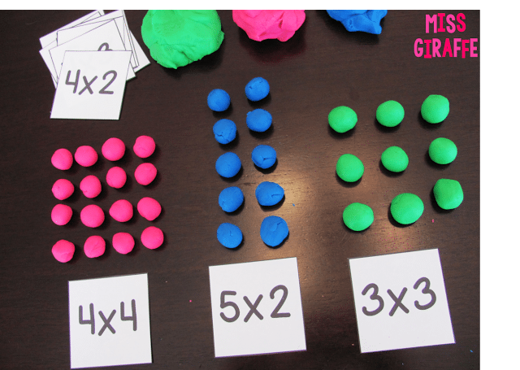
Children will be given six seconds to answer each of the questions, with a three second blank gap between each question.
The six-second time limit per question has been decided on by the DfE because it should allow children enough time to demonstrate their recall of times tables without giving them the time to work out the answers to each question.

Slide 11
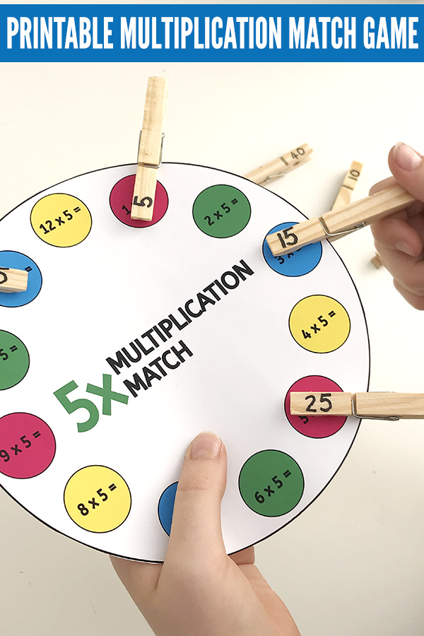
The questions will be randomly selected by the testing programme from 121 different options, ranging from 2 x 2 = up to 12 x 12.
The test’s software has been programmed to show children more questions from the 6, 7, 8, 9 and 12 times tables, as these are trickier times tables focused on more in Years 3 and 4. (The 2s, 5s and 10s are more of a focus in Years 1 and 2.)

Slide 12
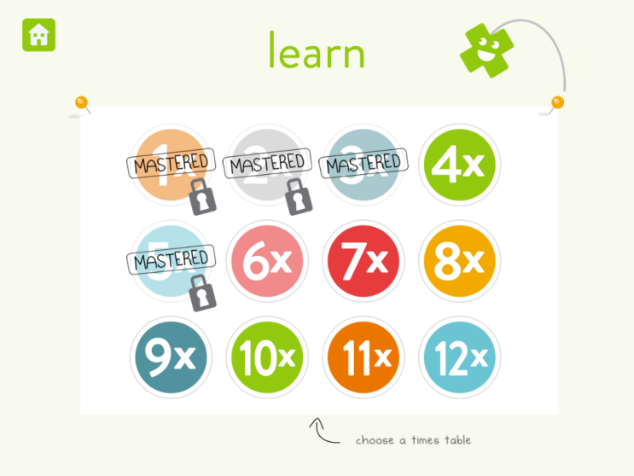
There will be no questions from the 1 times table (i.e. 1 x 8 or 8 x 1)
There will only be a maximum of 7 questions from the 2, 5
and 10 times tables.

Slide 13
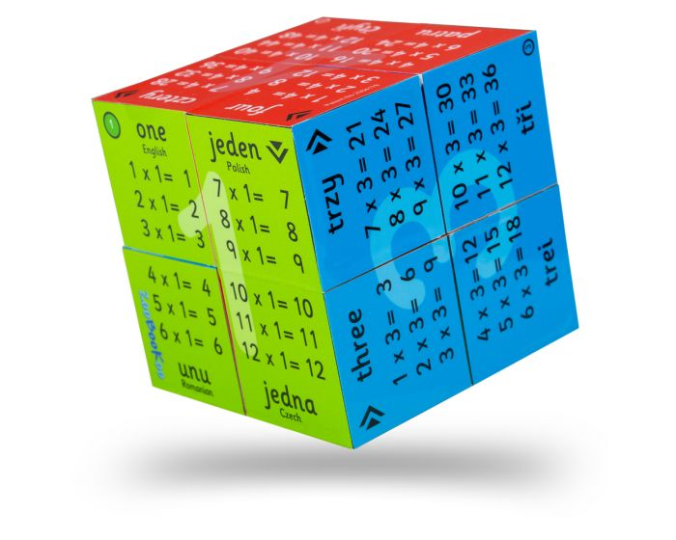
If children are shown a multiplication one way round, for example, 6 x 7, they will not be later tested on the multiplication inverted – so, with the
example provided the
child would not be
asked 7 x 6 later on in
their set of 25 questions.

Slide 14
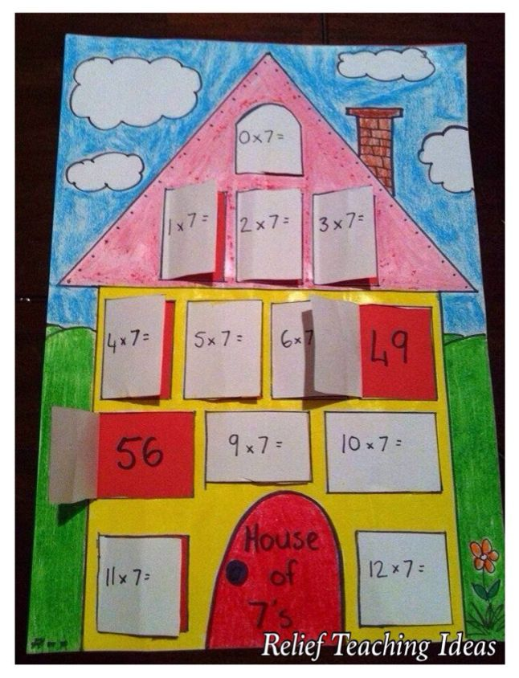
6 x 3 Is ‘6, Three Times’.
The STA state that they are
classifying the multiplication tables
by the first number in the question. For example, 8 x 3 would fall within the 8 times table.
This reflects what is now considered to be best practice – for example, that 8 x 3 should be thought of as 8, three times rather than 8 lots of 3.

Slide 15
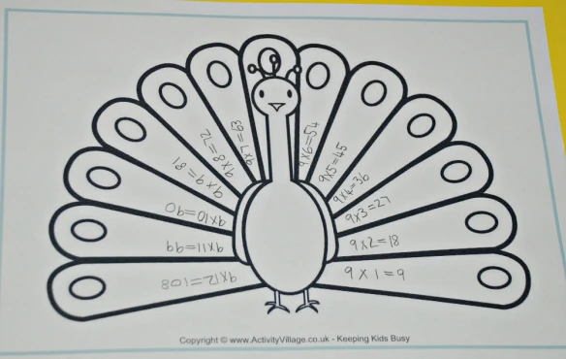
How will the Year 4 times tables test scores be reported?
Each child’s result will be passed on to their school, and the DfE will create a report on overall results across all schools in England to measure whether national times tables results improve over the coming years.
The school will then report
to parents their child’s score.

Slide 16
What if my child does badly in their multiplication tables check?
There will be no “pass mark” and therefore no child will “fail”. It is also important to note that all children will be tested on, is their times tables knowledge

Slide 17
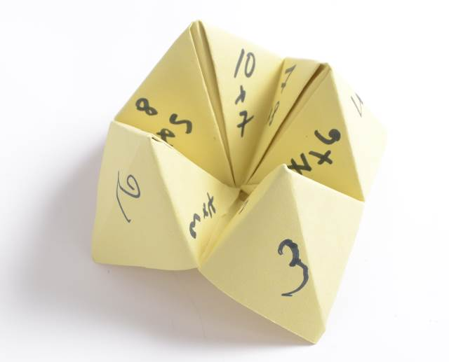
What can you do to help your child in practising their times tables?
Times tables chanting: “6, 12, 18, 24…”;
Times tables chanting in reverse order: “108, 99, 90, 81…”;
Using times tables songs, Percy Parker;
Using apps, like the one by Times Tables Rock Stars or Hit the Button;
Using free online games, like those on Maths Frame;

Slide 18
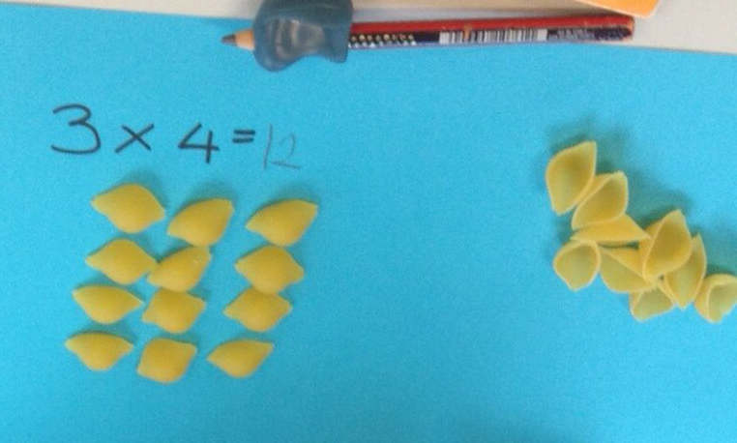
Asking your child multiplication calculations out of order, like: “What is 4 x 7? What is 9 x 5? What is 6 x 11?”;
Using pasta pieces or pebbles to show groups of numbers representing times tables, e.g. four groups of three pasta shells to show 3 x 4 = 12;

Slide 19
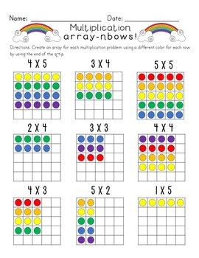
Asking your child related short division questions, like “What is 12 divided by 4? What is 55 divided by 11?”;
Asking your child word problems based on times tables, like: “If five friends have £3 each, how much money do they have in total?”;
Trying out active ways of learning times tables, like the times tables pavement chalk ideas

