Slide 1
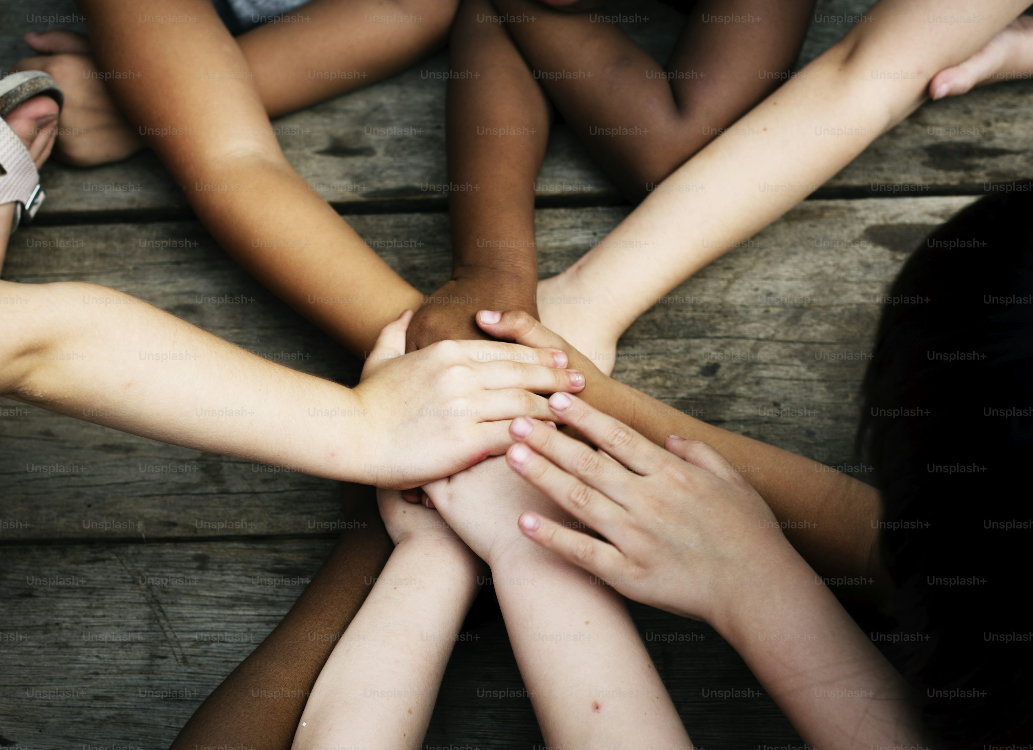

Racial Justice Sunday
Sunday 1st February 2026

Slide 2
Today we gather to mark Racial Justice Sunday which takes places in our parish churches on Sunday 1st February.

Slide 3
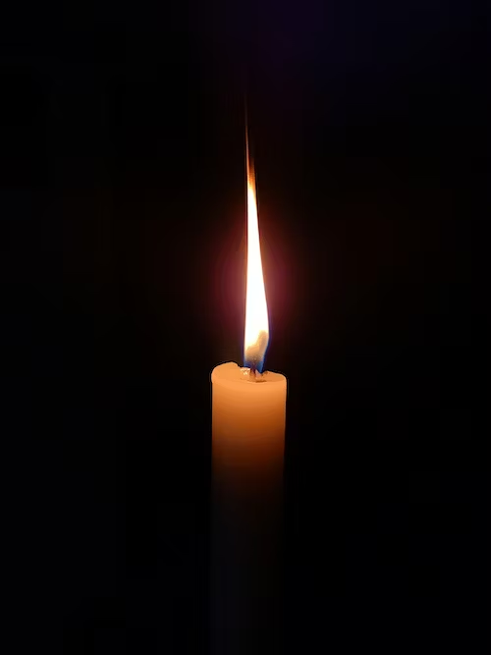
We Gather today. Let us put our hands together.
God, you are the Father of us all.
Thank you for making every person
special and loving us all.
As we gather today, help us to
listen to your word.
Help us to see you in one another,
and teach us to be loving and kind,
not just in what we say,
but in what we do.
We ask this through Jesus our Lord.
Amen
Gather
Notes:
Let us begin in prayer and turn to God –
Quieten your mind and heart and I invite you to make the sign of the cross –
In the name of the Father, Son and Holy Spirit
God, you are the Father of us all.
Thank you for making every person special and loving us all.
As we gather today,
help us to listen to your word.
Help us to see you in one another,
and teach us to be loving and kind,
not just in what we say, but in what we do.
We ask this through Jesus our Lord.
Amen.

Slide 4
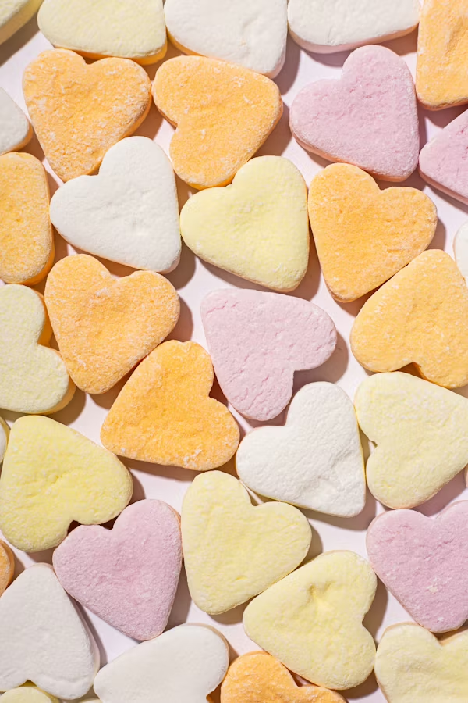
The Bishops have declared that the theme for Racial Justice Sunday 2026 is –
“ Whoever loves God must also love his brother and sister”
The words ‘brother and sister’ do not refer to our siblings but to the Catholic belief that we are all children of God so everyone is part of God’s family.
Racial Justice Sunday Theme
Notes:
The Bishops have declared that the theme for Racial Justice Sunday 2026 is –
“Whoever loves God must also love his brother and sister”
The words ‘brother and sister’ do not refer to our siblings but to the Catholic belief that we are all children of God so everyone is part of God’s family.

Slide 5
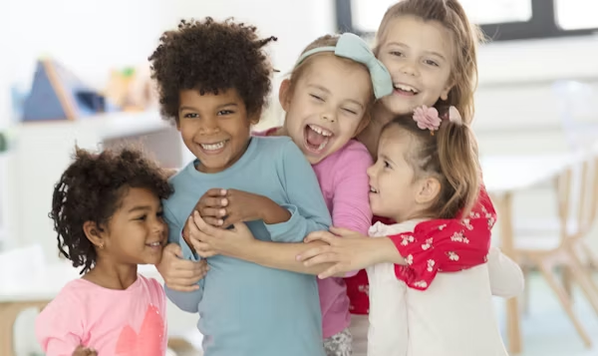
These words are taken from the Bible so let’s hear what it says -
A reading from the First Letter of John
‘Whoever claims to love God yet hates a brother or sister is a liar.
For whoever does not love their brother and sister, whom they have seen, cannot love God, whom they have not seen. And he has given us this command: Anyone who loves God must also love their brother and sister.’
The Word of the Lord - Thanks be to God.
Listen
Notes:
A reading from the First Letter of John
Whoever claims to love God yet hates a brother or sister is a liar. For whoever does not love their brother and sister, whom they have seen, cannot love God, whom they have not seen.
And he has given us this command: Anyone who loves God must also love their brother and sister.
The Word of the Lord - Thanks be to God.

Slide 6

In this scripture John speaks very clearly.
Loving God and loving others cannot be separated.
If we truly love God, that love must be visible in
how we treat each other – especially those who may
be different from us in culture, language, appearance
, or background as everyone is a child of God.
Prejudice and racism have no place in the life of a Christian
or in a Catholic school.
Racial justice calls us to recognise the dignity of every
person and to challenge attitudes or behaviours that harm others.
Our Church and schools are beautifully diverse.
People from every nation, culture, and background
belong to the one family of God.
Listen
Notes:
In this scripture John speaks very clearly.
Loving God and loving others cannot be separated.
If we truly love God, that love must be visible in how we treat each other – especially those who may be different from us in culture, language, appearance, or background as everyone is a child of God.
Prejudice and racism have no place in the life of a Christian or in a Catholic school.
Racial justice calls us to recognise the dignity of every person and to challenge attitudes or behaviours that harm others.
Our Church and schools are beautifully diverse.
People from every nation, culture, and background belong to the one family of God.

Slide 7
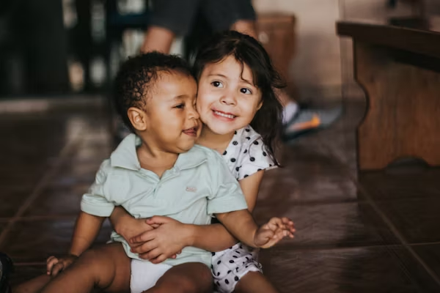
Let us silently reflect on how we live out this truth in our school and wider community by considering our answers to these three questions.
(Invite pupils to pause for a 2 minute silence, and reflect and consider these questions)
* How do I treat people who are different
from me?
* What might God be asking me to change?
Respond
Notes:
Let us silently reflect on how we live out this truth in our school and wider community by considering our answers to these three questions.
(Invite pupils to pause for a 2 minute silence, and reflect and consider these questions)
How do I treat people who are different
from me?
What might God be asking me to change?

Slide 8

Bow your head and close your eyes as we bring our thoughts and prayers before God, trusting in his love and mercy.
For the Church, that she may always be a place of welcome, dignity, and justice for people of every race and culture.
Lord hear us…
Lord graciously hear us
For our world, where racism and division still exist, that hearts may be changed and justice may flourish.
Lord hear us…
Lord graciously hear us
Let us pray
Notes:
Bow your head and close your eyes as we bring our thoughts and prayers before God, trusting in his love and mercy.
For the Church, that she may always be a place of welcome, dignity, and justice for people of every race and culture.
Lord hear us…
Lord graciously hear us
For our world, where racism and division still exist, that hearts may be changed and justice may flourish.
Lord hear us…
Lord graciously hear us

Slide 9
For our community, that we may challenge prejudice and learn to listen, respect, and support one another.
Lord hear us…
Lord graciously hear us
For our school, that we may be a place where racism is challenged, diversity is celebrated, and every person is welcomed as a child of God.
Lord hear us…
Lord graciously hear us
Let us pray
Notes:
For our community, that we may challenge prejudice and learn to listen, respect, and support one another.
Lord hear us…
Lord graciously hear us
For our school, that we may be a place where racism is challenged, diversity is celebrated, and every person is welcomed as a child of God.
Lord hear us…
Lord graciously hear us
Loving God, we place these prayers before you, confident that you hear us.
Through Christ our Lord. Amen.

Slide 10

Racial justice is not just
something we reflect
on today- it is something
we are called to live
every day.
Mission
Notes:
Racial justice is not just something we reflect on today- it is something we are called to live every day.

Slide 11
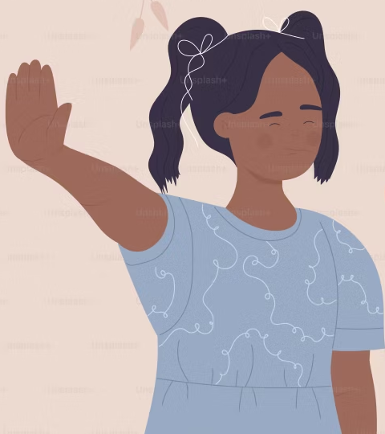
As we go from here, remember to:
Treat everyone with respect – use kind words, listen to others, and never tease or leave people out.
Speak up when something is unfair – tell a trusted adult and stand by those who need help.
Mission
Notes:
As we go from here, remember to:
Treat everyone with respect – use kind words, listen to others, and never tease or leave people out.
Speak up when something is unfair – tell a trusted adult and stand by those who need help.
KS1 - Simpler Version:
- Be kind to everyone.
- Tell a grown-up if something is not fair.

Slide 12
We will now close our Celebration of the
Word in prayer.
I invite you to make the sign of the cross –
In the name of the Father, the Son and the Holy Spirit
Lord God,
Send us out as witnesses of your love.
Help us to recognise Christ
in every person and to work for
justice, peace, and unity in our world.
May our school be a place where everyone is valued and loved.
We ask this through Christ our Lord.
Amen
Sending Forth
Notes:
We will now close our Celebration of the Word in prayer.
I invite you to make the sign of the cross –
In the name of the Father, the Son and the Holy Spirit
Lord God,
Send us out as witnesses of your love.
Help us to recognise Christ
in every person and to work for
justice, peace, and unity in our world.
May our school be a place where everyone is valued and loved.
We ask this through Christ our Lord.
Amen.

Slide 13
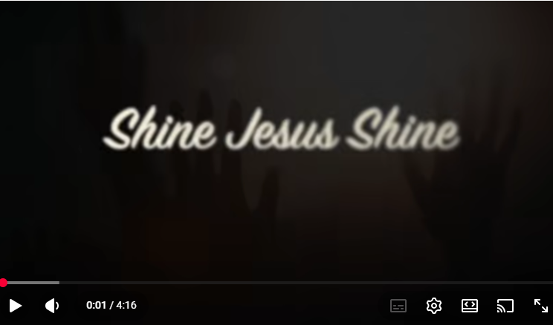
Let us now end our Celebration of the Word with a song.
Shine Jesus Shine
https://www.youtube.com/watch?v=E_i-GxtbD54

