Slide 1

Welcome to Year 1
September 2026
Mrs Reimus – class teacher
Mrs Yu – 1:1 LSA
Mrs Bouchelaghem – 1:1 LSA

Slide 2
Our Mission
At St Theresa’s
We learn together,
We play together,
We pray together and
We grow together in the love of God.

Slide 3

What to expect in Year 1
• A gentle transition from Reception
• Growing independence and confidence
• Purposeful, engaging learning
• First-hand experiences indoors and outdoors
• A strong partnership between home and school

Slide 4

Our Classroom Expectations
In Year 1, we:
listen carefully
use kind words and kind hands
share and take turns
help one another
look after our classroom
show respect
always try our best

Slide 5


Celebrating Positive Choices
We notice and celebrate children who follow our class expectations, work hard and show kindness.
Children may receive Class Dojo points and other praise for their positive choices and achievements.
Star of the week certificate
Weekend with Barnaby Bear
House points

Slide 6

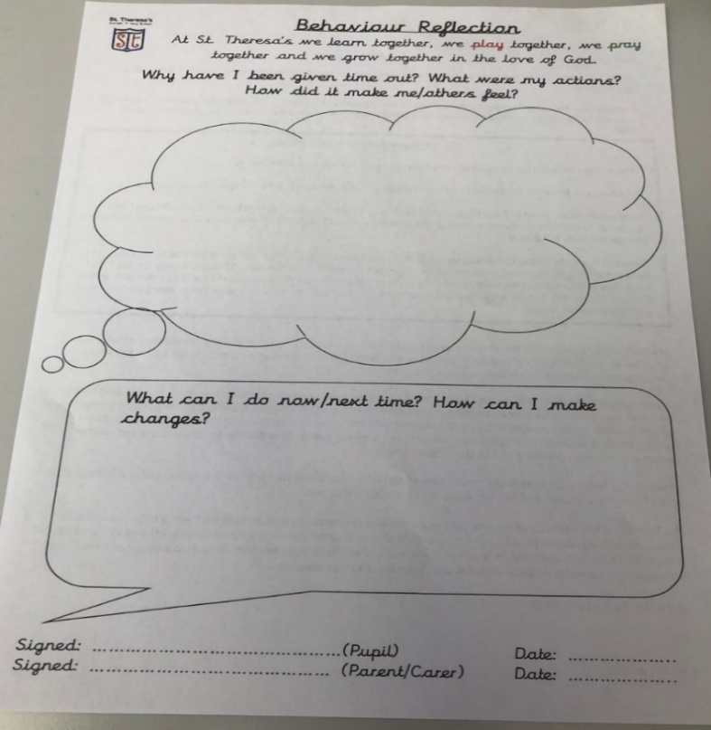
When Things Go Wrong
Children are supported to understand what happened and make a better choice.
The usual steps are:
a reminder or warning
time to reflect in class
reflection time in another class, if needed
RED CARD: a reflection sheet is sent home for a parent or carer to sign and return.

Slide 7





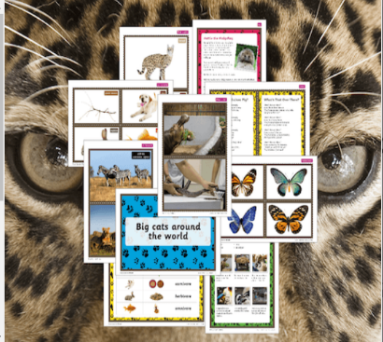
Topics This Year
Autumn 1 Memory Box
Autumn 2 Superheroes
Spring 1 Moon Zoom!
Spring 2 Splendid Skies
Summer 1 Bright Lights, Big City
Summer 2 Paws, Claws and Whiskers

Slide 8
Autumn 1: Memory Box
This half term, children will:
compare the past and present through toys and photographs
read Lost in the Toy Museum, The Everywhere Bear and Knuffle Bunny
build confident sentence writing
explore place value within 10
name body parts and investigate the senses
learn about Creation and Covenant in RE

Slide 9
A Typical School Day
8:40 Children arrive and complete an early morning task
8:50 Register
9:00 Assembly/ Phonics, English/ handwriting
10:15 Morning break
10:30 Maths
11:30 Lunch
12:30 Afternoon learning: science/ topic/ RE/PSHE/ Art/ Computing/Guded Reading/PE
3:15 Home time

Slide 10
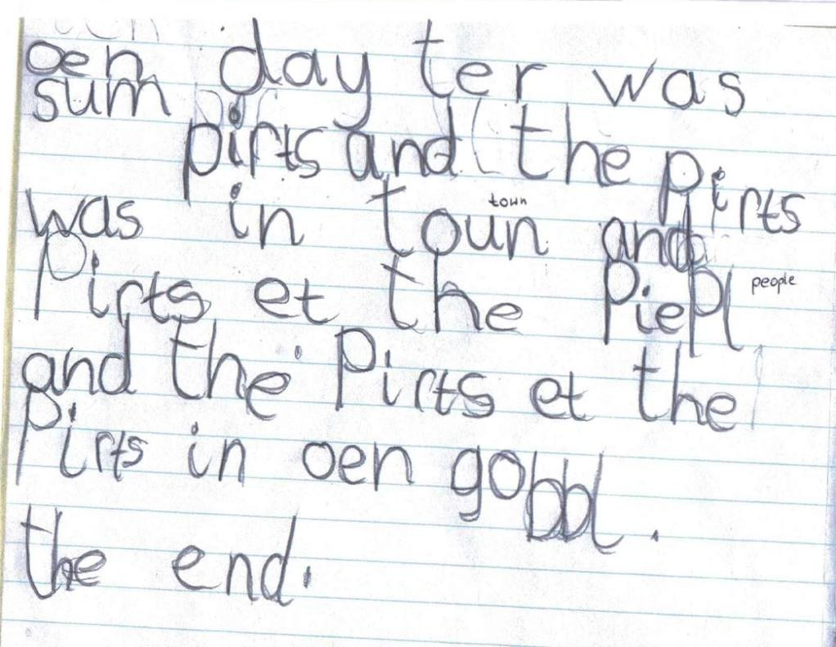
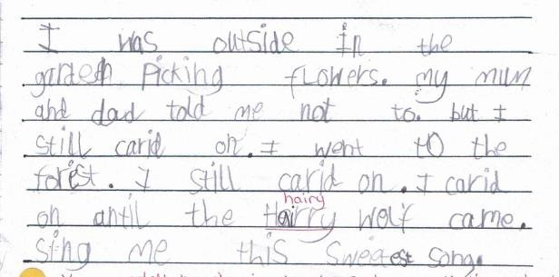
Writing in Year 1
Reception
Children write recognisable letters, spell words using their phonics and begin to write simple sentences.
Year 1
Children say a sentence aloud before writing it, form letters carefully and reread their work. They use finger spaces, capital letters and end punctuation, and begin joining ideas with “and”.

Slide 11
How Reading Develops in Year 1
Reception
• Blend sounds to read words
• Read simple phonically matched books
• Recognise some tricky words
• Talk about what they have read
Year 1
• Apply a growing knowledge of phonics
• Read unfamiliar words more confidently
• Build fluency and expression
• Learn common exception words
• Discuss characters, events and meaning

Slide 12

Reading in Year 1
Children take part in three reading-practice sessions each week, focusing on decoding, fluency and understanding.
Please keep your child’s reading book and Reading Record in their book bag every day.
Read together at home each day and sign the Reading Record. A few calm, enjoyable minutes make a real difference.

Slide 13
Weekly Spellings
Ten spelling words will be shared on Seesaw each Friday, one week before the test.
Please help your child practise the words little and often during the week. The spelling test will take place the following Friday.
Children keep a record of their words in their spelling book at school, so home practice does not need to be uploaded.

Slide 14
Mathematics in Year 1
Children will learn to:
count forwards and backwards to and across 100
read and write numbers to 20 in numerals and words
find one more and one less
add and subtract within 20
use the signs +, − and =
count in 2s, 5s and 10s
solve practical one-step problems
recognise halves and quarters

Slide 15
Home Learning
Every Tuesday, children will receive a new reading book.
Every Friday, children will receive English and Maths homework (Reading Eggs and My Maths).
Occasionally, a short cross-curricular activity may be set in science, art, history, RE or geography. Any task will be explained clearly on Seesaw.

Slide 16
The Phonics Screening Check
The statutory Phonics Screening Check takes place in June.
Each child reads 40 words individually with a familiar teacher. The list contains real words and carefully designed pseudo-words.
The check helps us see how confidently children can recognise sounds and blend them to read unfamiliar words.
We practise these skills naturally throughout the year through daily phonics and reading. There is no need for children to feel worried about the check.
Examples

Slide 17
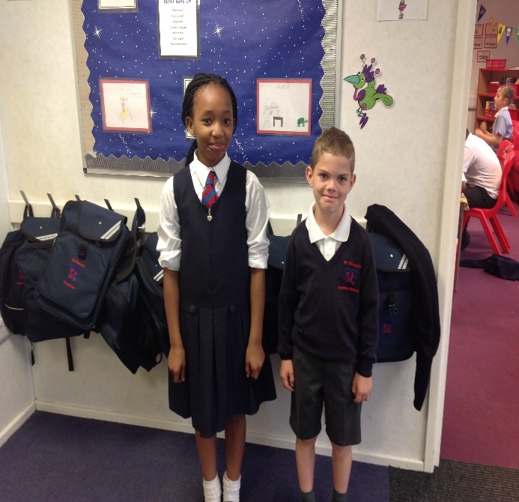
Uniform and Presentation
Please follow the school uniform policy.
• Correct school uniform
• Suitable navy coat for the weather
• Grey socks for boys
• White socks or navy tights for girls
• School fleece, hat, scarf and gloves when needed
• Long hair tied back
Please label every item clearly. Children should arrive looking smart, with shirts tucked in and ready to learn.

Slide 18
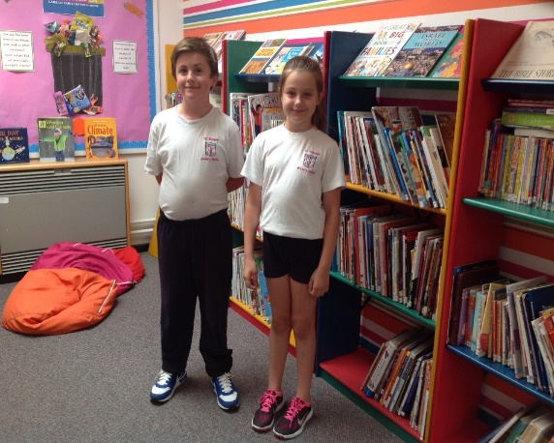

PE and Water
PE day: Tuesday and Friday
Children should come to school wearing their PE kit.
PE kit
• White school-logo T-shirt
• Shorts for indoor PE
• Tracksuit for outdoor PE
• Trainers
Water bottles
Please send a named water bottle every day.

Slide 19
Keeping in Touch
Teachers cannot hold meetings with parents while teaching or supervising children.
If you would like to talk, please speak to me briefly after school to arrange an appointment, or contact the school office. I will then arrange a mutually convenient time.
Please check Seesaw and the school website regularly for messages, dates and updates.
www.st-theresas.barnet.sch.uk

Slide 20

Helping at Home
• Arrive on time, ready for the day
• Keep reading books and records in the book bag
• Read together every day
• Practise phonics and the weekly spelling words
• Practise letter formation and numbers to 20
• Label clothing, PE kit, bags and water bottles
• Check Seesaw and the school website regularly
Your encouragement and praise are incredibly valuable.

Slide 21
Working Together
We can help every child thrive in Year 1.
Questions?

